Slide 1


Wearable devices for epidemiologic research Daniel Fuller, PhD Associate Professor Department of Community Health and Epidemiology March 25, 2024

Slide 2
Conflicts of Interest
No conflicts to disclose

Slide 3
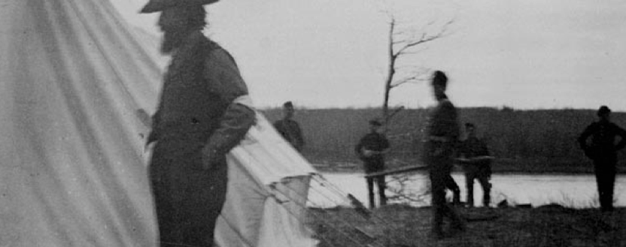
I acknowledge our shared connection to the land and recognize that Indigenous and Métis peoples on Treaty 6 Territory and all Indigenous peoples have been and continue to be stewards for social justice, equity, and land-based education. I also recognize that McGill University is on unceded lands belonging to the Haudenosaunee and Anishinaabeg nations. In the spirit of reconciliation may we all strive to learn and support the work of Indigenous communities as allies and return their land.

Slide 4
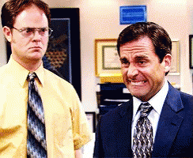
Please
Ask questions
Tell me to slow down
Sorry for
Typos
Going to fast

Slide 5
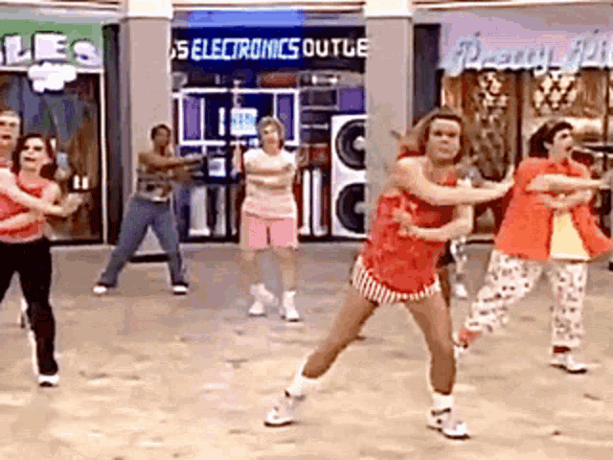
Physical activity is really good for you
Attributable to low physical activity
15.74 million (8.51–28.61) DALYs/year
0.83 million (0.43–1.47) death/year
Strongly associated with risk reductions for many health outcomes

Slide 6
Physical activity is really good for you
MVPA – Moderate to vigorous physical activity
A fast walk or harder
LPA – Light physical activity (not MVPA or sedentary)
Sedentary – Sitting or lying down but not sleeping
METS – Metabolic equivalent of task
Work (energy/calories) required for a given activity (1 = lying, 14 = sprinting)

Slide 7
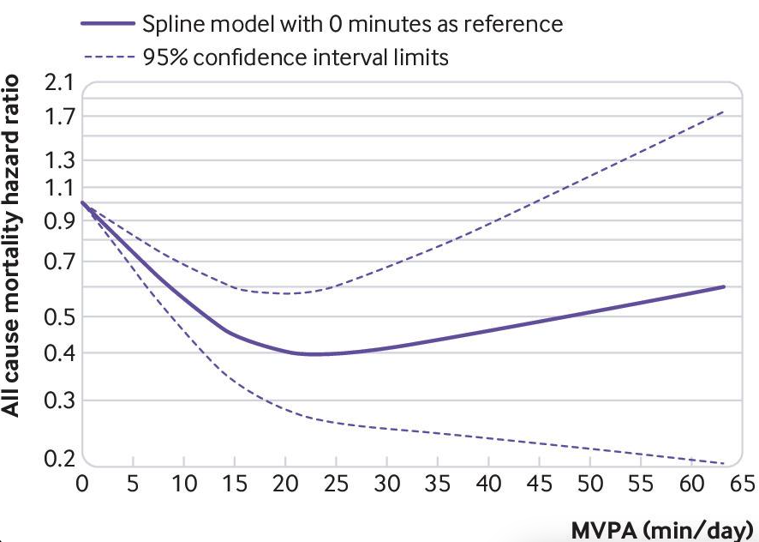

All cause mortality
https://www.bmj.com/content/366/bmj.l4570

Slide 8
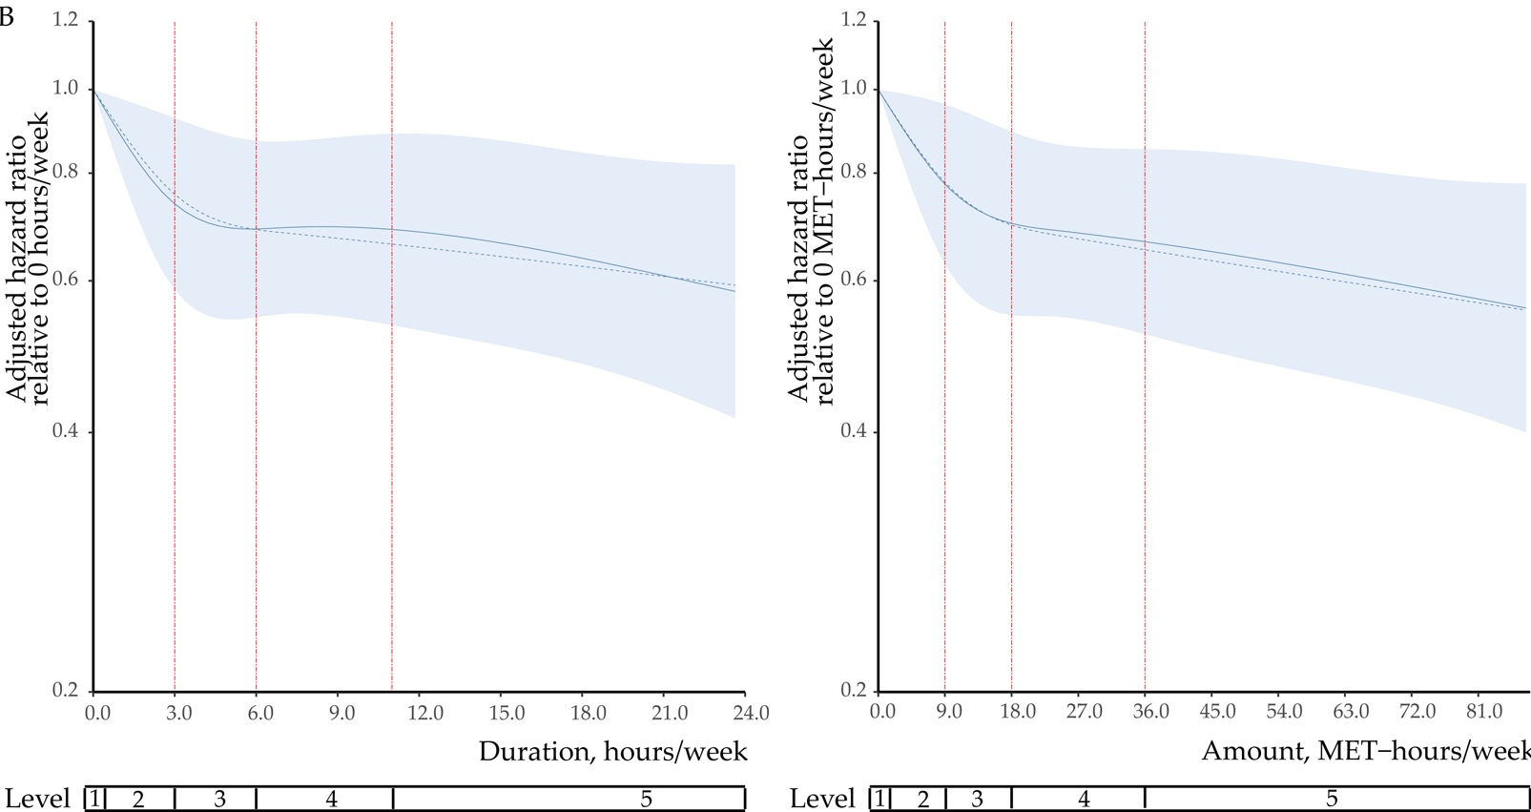
Late life PA and dementia

Slide 9
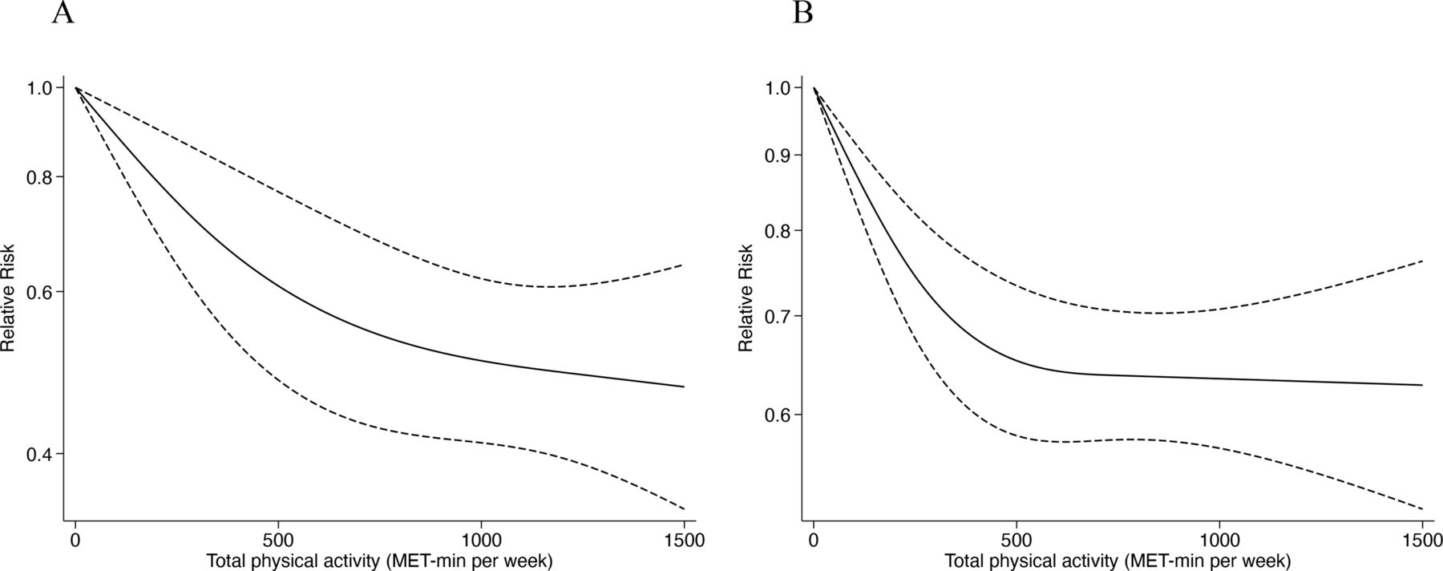
Severe COVID-19 illness and death

Slide 10
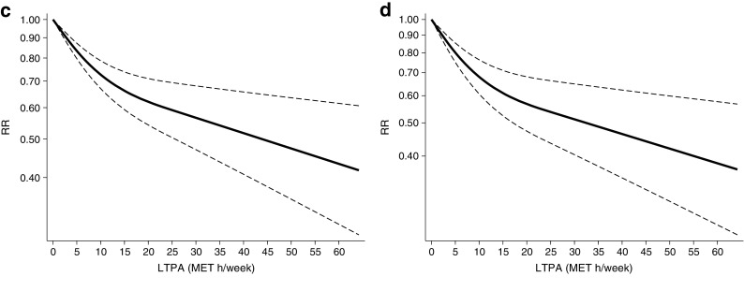
Diabetes

Slide 11
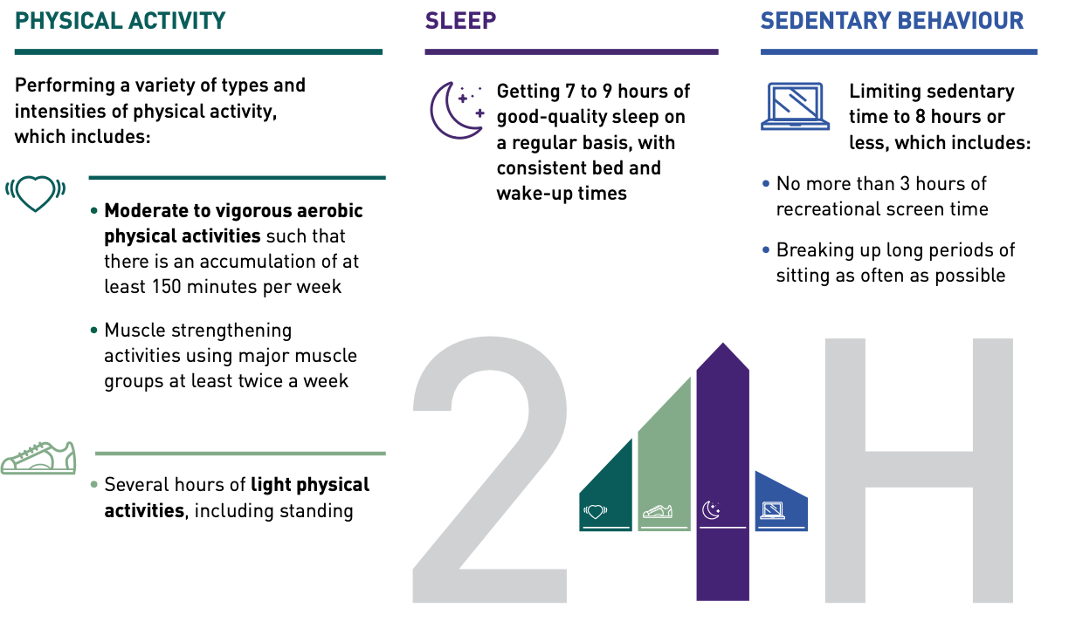
https://www150.statcan.gc.ca/n1/pub/82-003-x/2019008/article/00001-eng.htm
https://csepguidelines.ca/

Slide 12
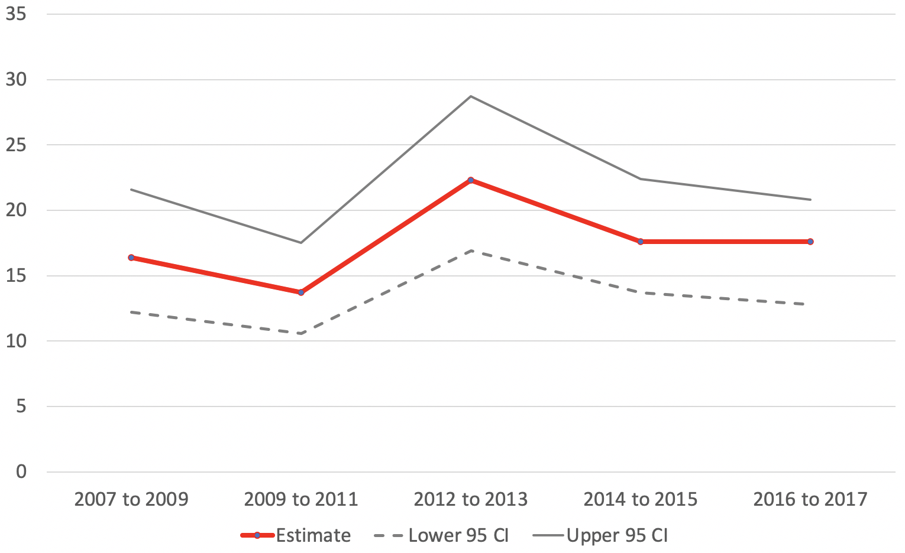
Trends in meeting PA guidelines
https://www150.statcan.gc.ca/n1/pub/82-003-x/2019008/article/00001-eng.htm

Slide 13
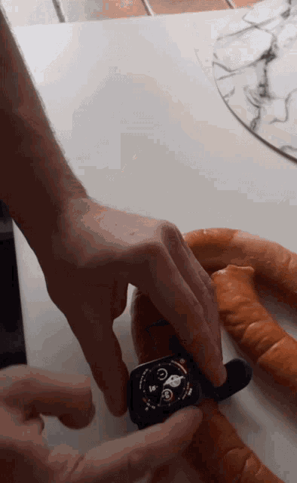

Wearable devices will solve all our problems
… or at least people will write many many commentary papers about this

Slide 14
Research Areas
Two broad researchers areas focusing on this work
Human Activity Recognition (Computer Science focus)
"A theory-based model of cumulative activity”
https://www.nature.com/articles/s41598-022-18982-3
Physical activity measurement (Health Science focus)
"Wearable Device Validity in Measuring Steps, Energy Expenditure, and Heart Rate Across Age, Gender, and Body Mass Index: Data Analysis From a Systematic Review”
https://doi.org/10.1123/jpah.2022-0160
Not much overlap between the two areas (unfortunately)

Slide 15
Measuring stuff using wearables
Accelerometry
Temperature sensors
Photoplesmography (the lights on your wrist)
GPS
EMG
For each measurement device (or using sensor fusion), algorithms exist for estimating physical characteristics like step count, sleep, heart rate, heart rate variability, energy expenditure…

Slide 16
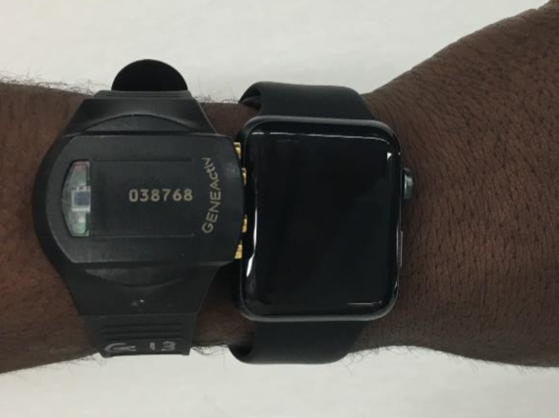
Research versus commercial wearables
Research grade devices
Open data collection and protocols (mostly)
Look terrible
Typical 7-10 day wear time
Commercial devices
Propriety measures
Have an app
Long term wear time

Slide 17
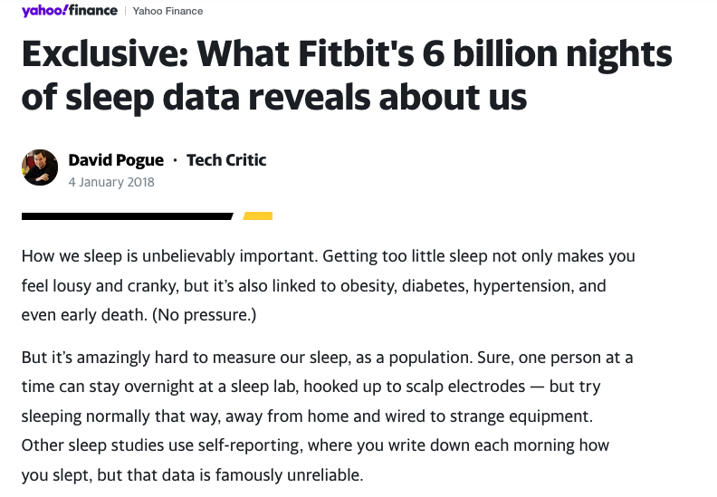
Research versus commercial wearables
Research grade devices
Open data collection and protocols (mostly)
Look terrible
Typical 7-10 day wear time
Commercial devices
Propriety measures
Have an app
Long term wear time

Slide 18
Scale of commercial devices
21% of Americans used smartwatches in 2019
~ 270 million wearables sold worldwide in 2022
~ 54 million Apple Watches sold in 2022
Google buys Fitbit for $2.1B in 2019

Slide 19


Scale of commercial devices
Analysis of ClinicalTrails.gov registry (2022)
Device | # of studies | Participants (mean)
Fitbit | 833 | 808
Garmin | 113 | 1038
Apple Watch | 96 | 218800
ActiGraph | 1218 | 167
Empatica | 59 | 1837
Other wearable devices | 895 | 2219
Total | 3214 (All) 1937 (Commercial)
https://doi.org/10.1177/17407745241230287

Slide 20
Validity and Reliability
… or it’s ok if the measures are terrible as long they are consistently terrible over time

Slide 21
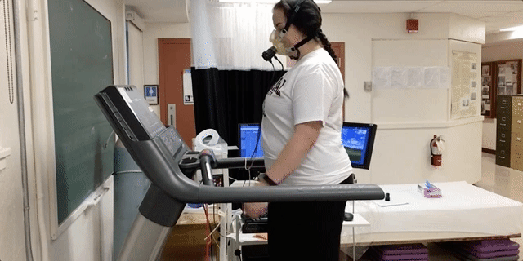
Criterion validity
Validation studies
Compare accuracy of a measure with a gold standard measure
https://www.ncbi.nlm.nih.gov/pmc/articles/PMC7750925/

Slide 22

Criterion validity
Critically important aspect of commercial wearable devices
Millions of people are making health decisions based on the data from these devices
Not enough to have devices that measure reliably
https://www.ncbi.nlm.nih.gov/pmc/articles/PMC7750925/

Slide 23
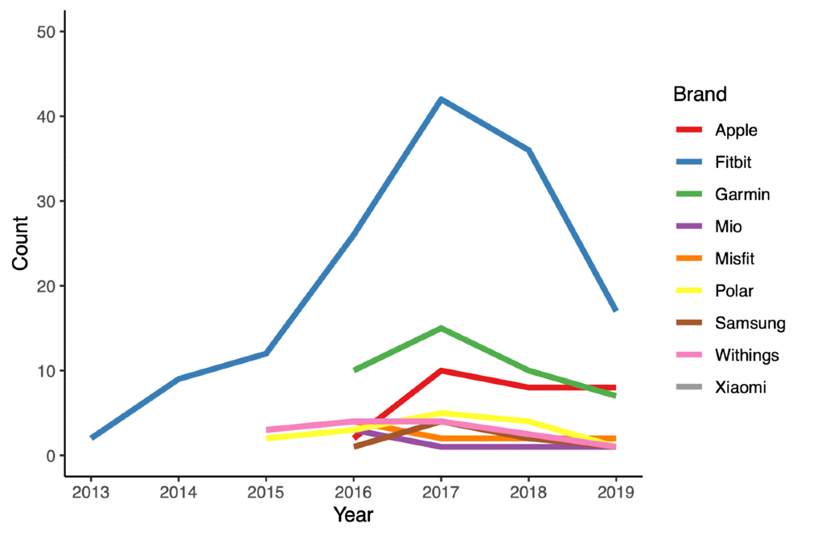
Systematic review
Publication year ranged from 2013 to 2019
158 publications, 169 studies/sub-studies identified
A total of 1838 comparisons
Validity n = 1672
Reliability n = 166

Slide 27
Discussion
Metrics don’t correspond to physical activity research
We are back calculating metrics for health benefit
10,000 steps (well more like 7500)
100 steps/min = MVPA
Very few reliability studies
But the devices tend to have good intra and inter-device reliability

Slide 28
Discussion
We need to go FASTER with these studies
All models included in the review were discontinued
Standard free living protocol might help
Algorithms exist in OS or firmware version not brand or model
It’s mostly just accelerometer data and algorithms
New firmware or OS could apply a completely new algorithm

Slide 29

Side Quest Brand agnostic machine learning models

Slide 30
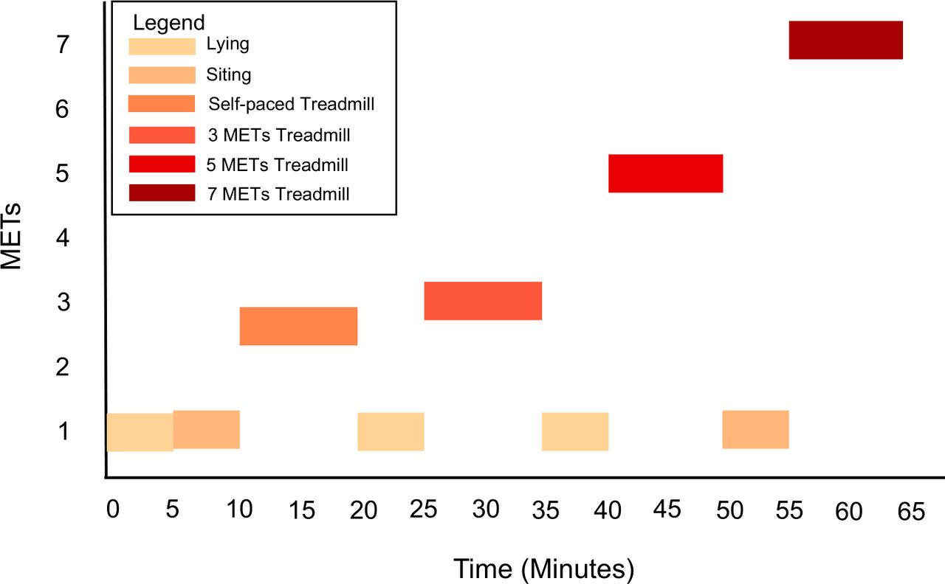

Slide 31
Brand agnostic models
Apple Watch
3656 minutes of data
Accuracy 82.6% - Rotation Forest models
Accuracy range 72.6% to 89.0%
Fitbit
2608 min of data, respectively.
Accuracy 90.8% - Random Forest models
Accuracy range 86.2% to 92.6%

Slide 32
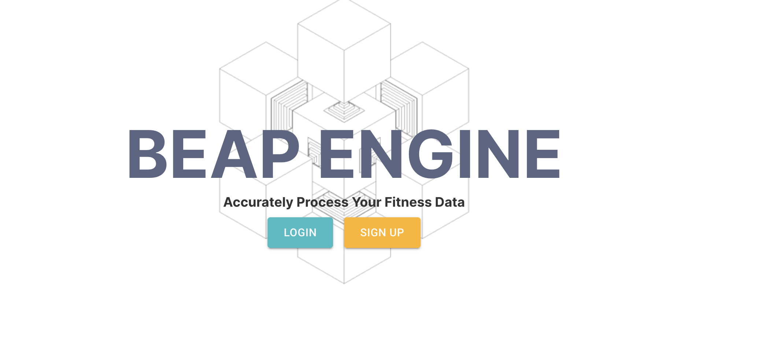

Slide 33

Side Quest Device firmware version

Slide 34

COV-FIT Study
PhD Student – Shelby Sturrock
To estimate the impact of software/firmware and hardware version on the measurement of daily activity metrics for Apple Watch devices
359 participants
892 transitions from one software version to the next
147 hardware transitions
Unpublished data
Showing descriptive plots only
https://www.covfitstudy.ca/

Slide 35
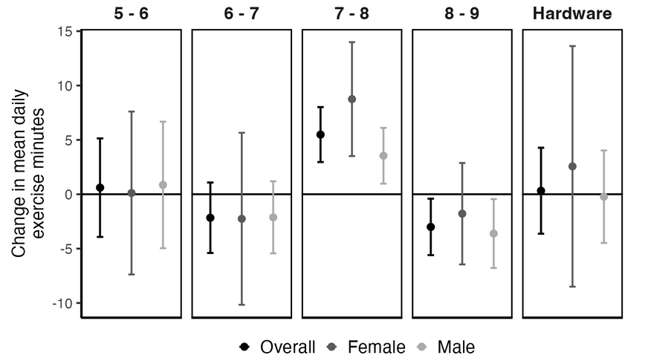
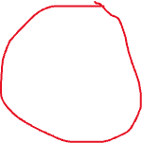
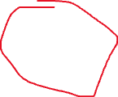
Software transitions

Slide 36
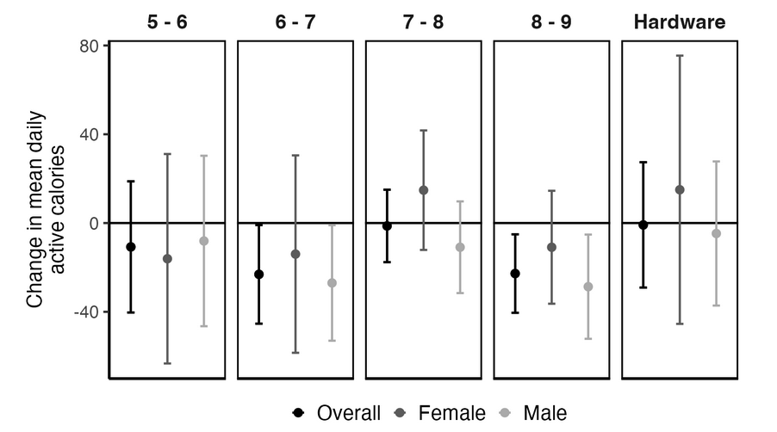
Software transitions

Slide 37

Openness
… or tech companies are just doing their thing

Slide 38
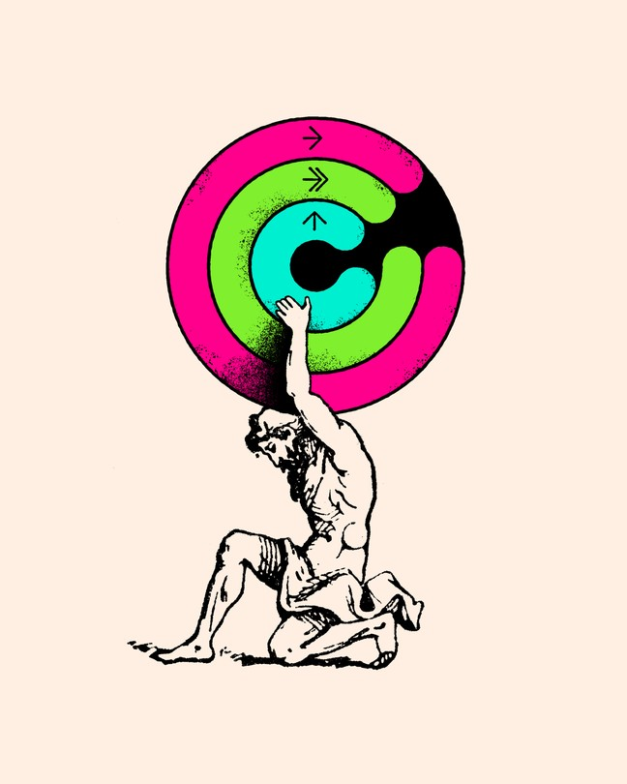
Where do we go?
Open algorithms
Equity/Bias research
Commercial determinants of health
https://www.theatlantic.com/technology/archive/2024/02/activity-trackers-calories-fitness/677320/

Slide 39

Open algorithms
Open algorithms
…Or at least sharing key details
More research on bias in these measures
Already have very good methods for this from Large Language Model research
Great interdisciplinary potential for computer science, epidemiology, ethics

Slide 40
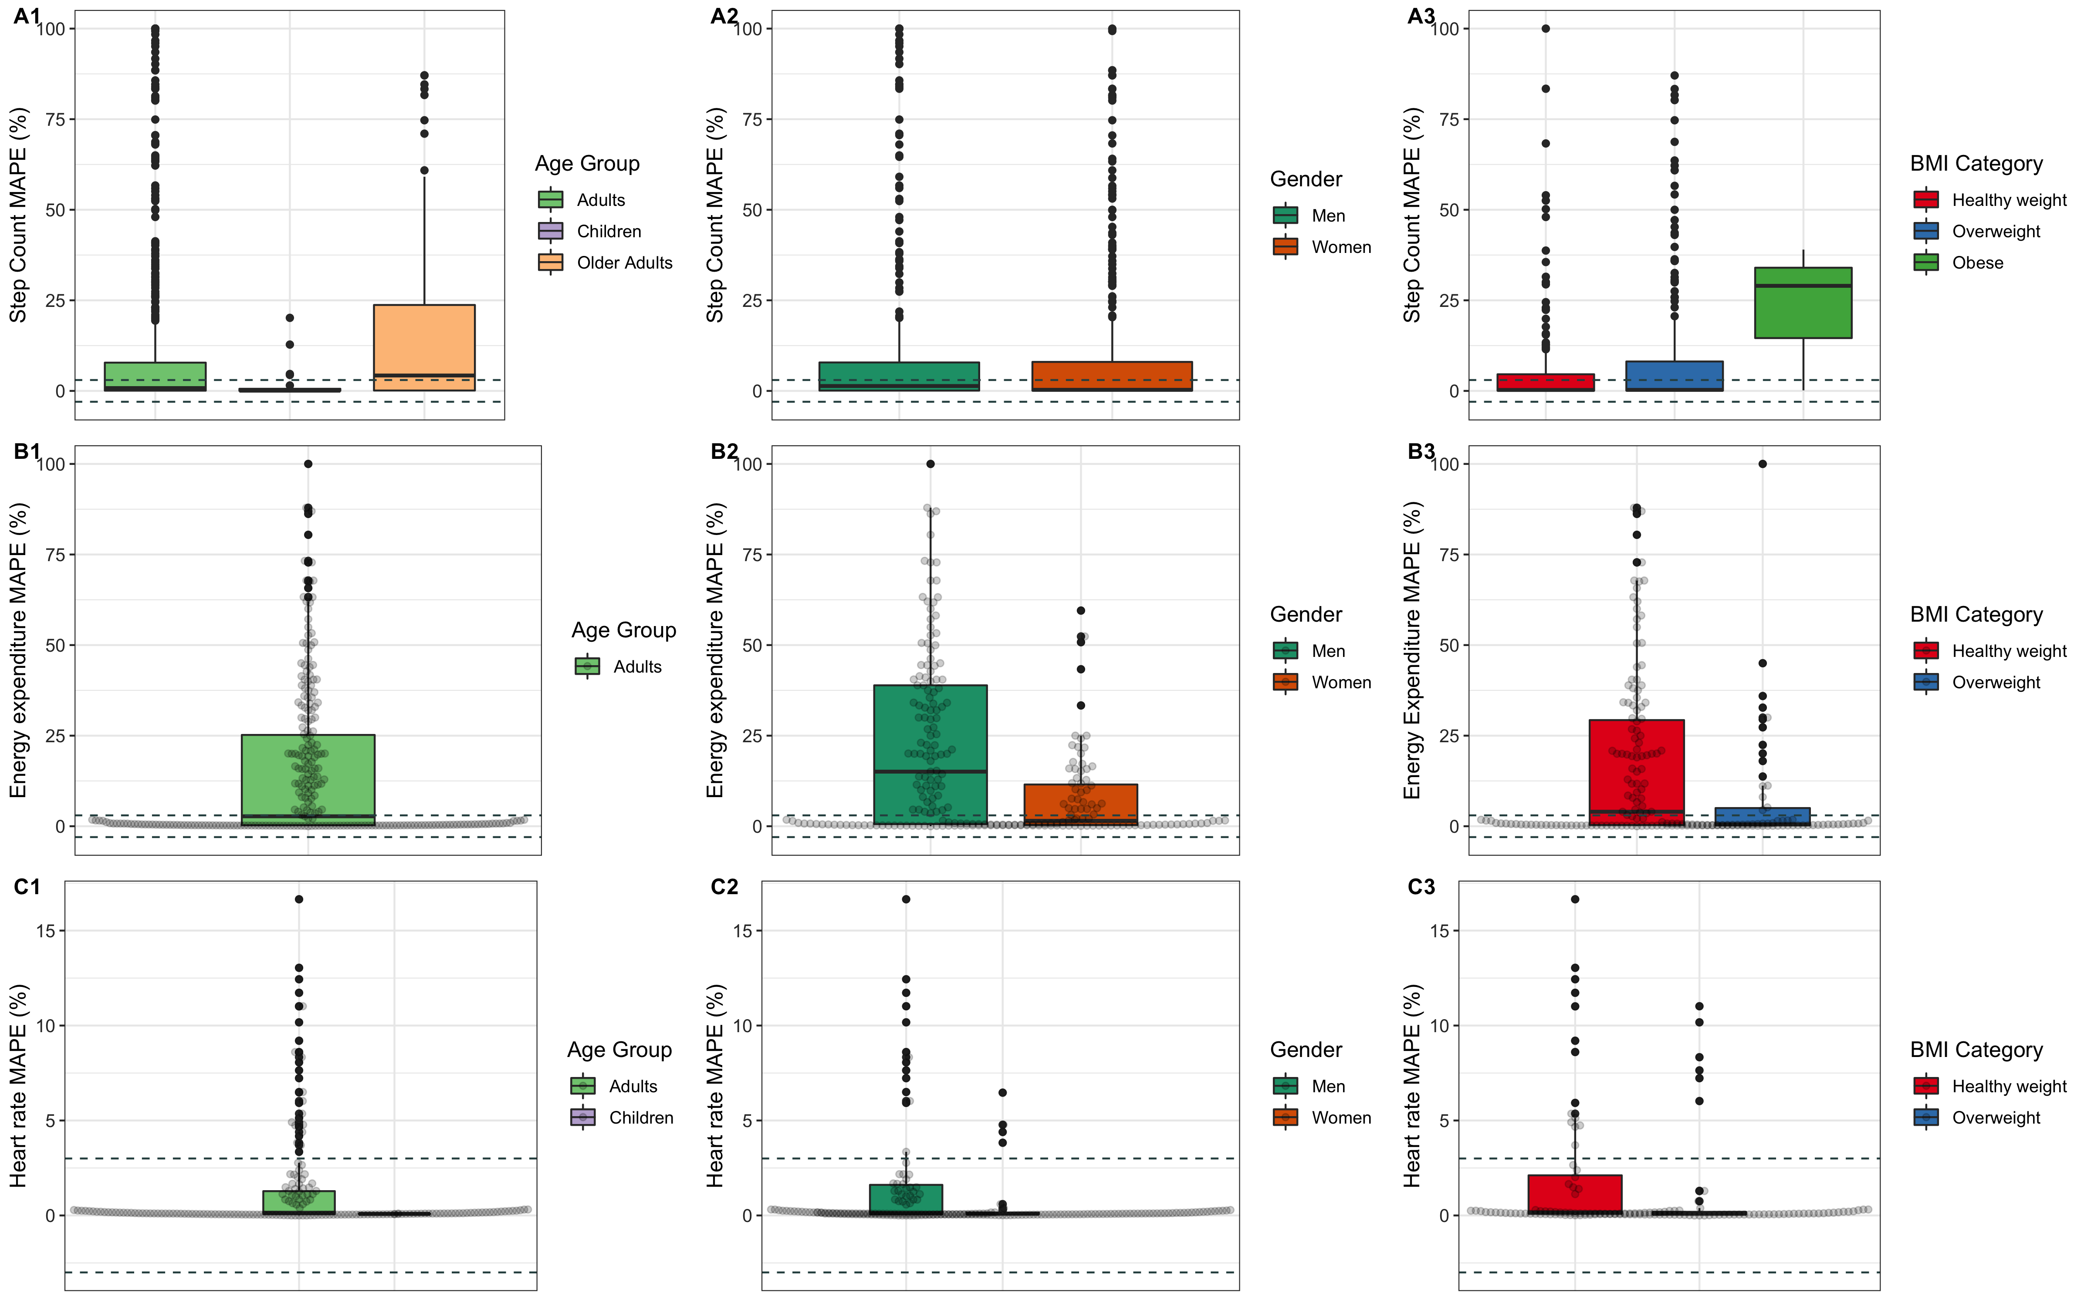
Equity/bias research

Slide 42
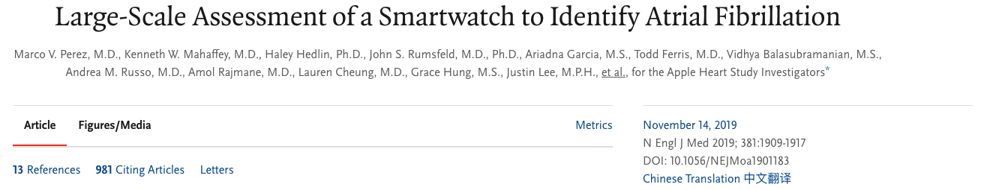
Commercial determinants of health
After obtaining the ECG, a proprietary algorithm classifies the ECG tracing as SR, AFib, or inconclusive in ECG 1.0. With ECG 2.0 where available, additional classifications such as AFib with high heart rate (HR 100–150) and additional differentiation between poor recording and inconclusive readings will also be available.
https://www.apple.com/healthcare/docs/site/Apple_Watch_Arrhythmia_Detection.pdf

Slide 43
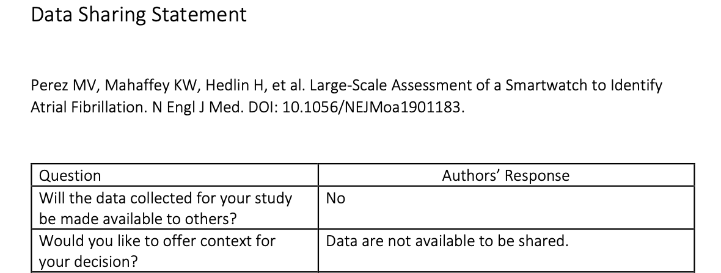

Commercial determinants of health
https://www.apple.com/healthcare/docs/site/Apple_Watch_Arrhythmia_Detection.pdf
After obtaining the ECG, a proprietary algorithm classifies the ECG tracing as SR, AFib, or inconclusive in ECG 1.0. With ECG 2.0 where available, additional classifications such as AFib with high heart rate (HR 100–150) and additional differentiation between poor recording and inconclusive readings will also be available.
https://www.nejm.org/doi/full/10.1056/NEJMoa1901183
https://www.thelancet.com/journals/lancet/article/PIIS0140-6736(23)00013-2/fulltext

Slide 44
A race to the bottom?
Steps
All day stress
Sleep
Resting heart rate
Calories
Pulse Ox
Sleep score
Respiration
Body battery
Fitness age
Intensity minutes
Vo2 max estimate
Recovery advisor
Race predictor
Stress score
Heart rate zones
Lactate threshold
Performance condition
Training load
Training effect
Real time stamina
Training readiness
Heart rate variability (HRV)
HRV Stress test
Training load focus
Running power
Training stress score
https://www.wareable.com/sport/every-garmin-metric-explained

Slide 45
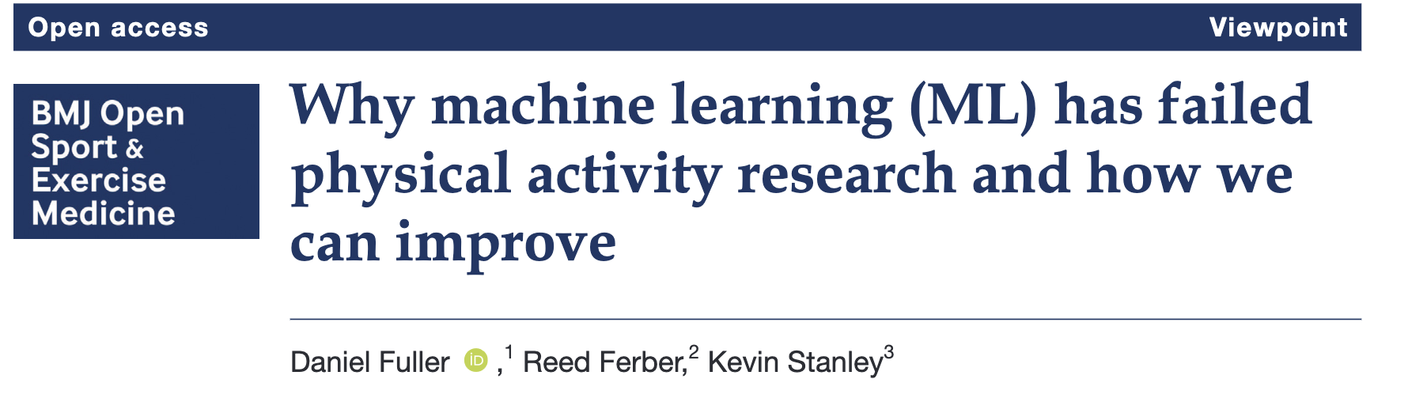

Slide 46
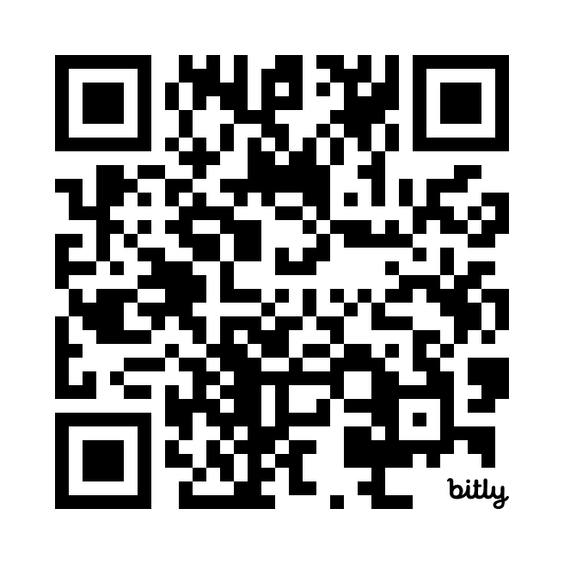
Thank you
daniel.fuller@usask.ca
@walkabilly

